Slide 1
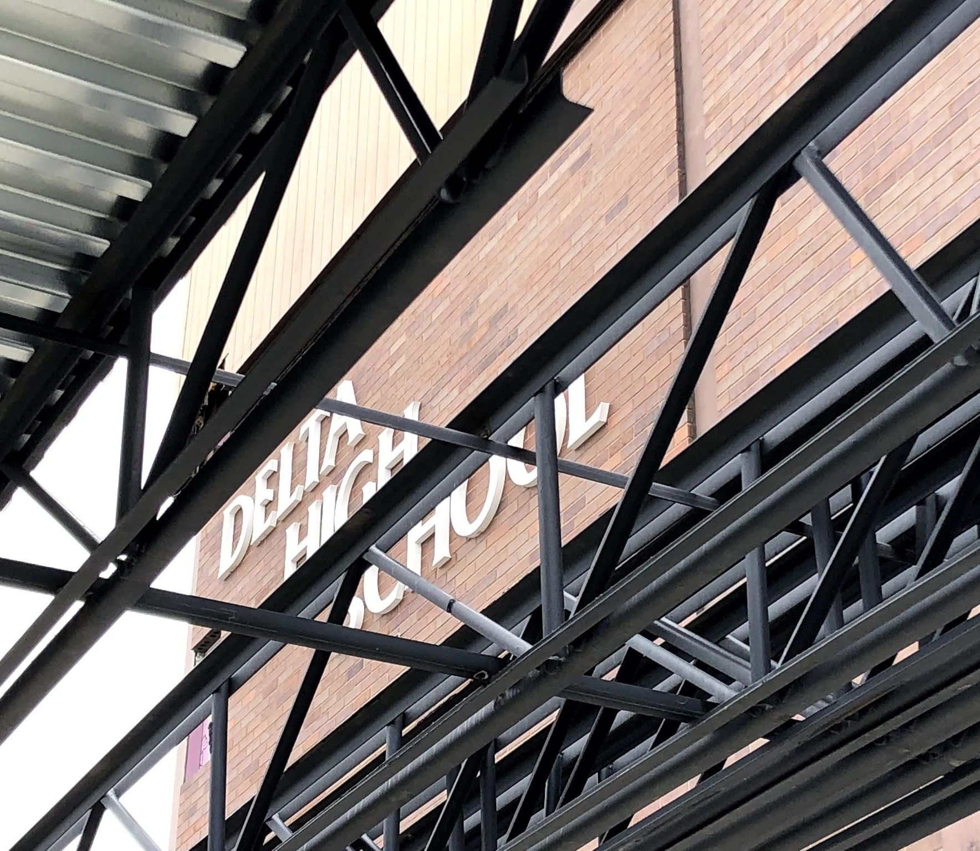
Project 2018
October 31, 2018

Slide 2
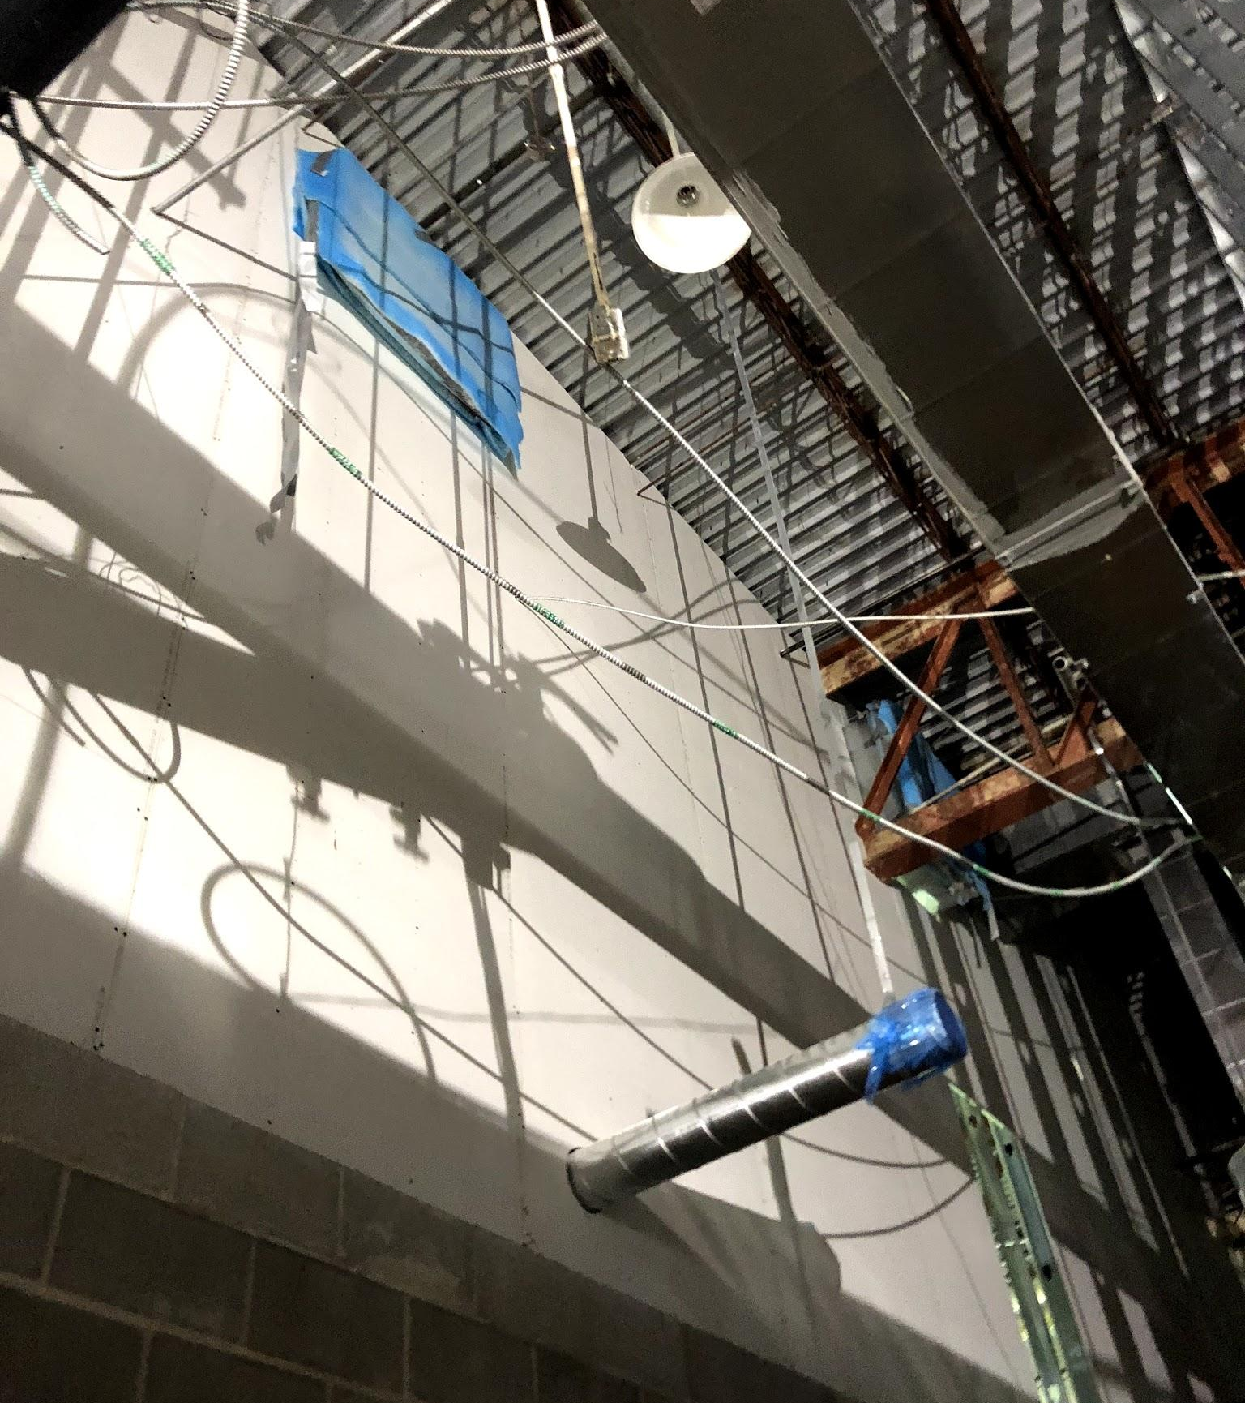
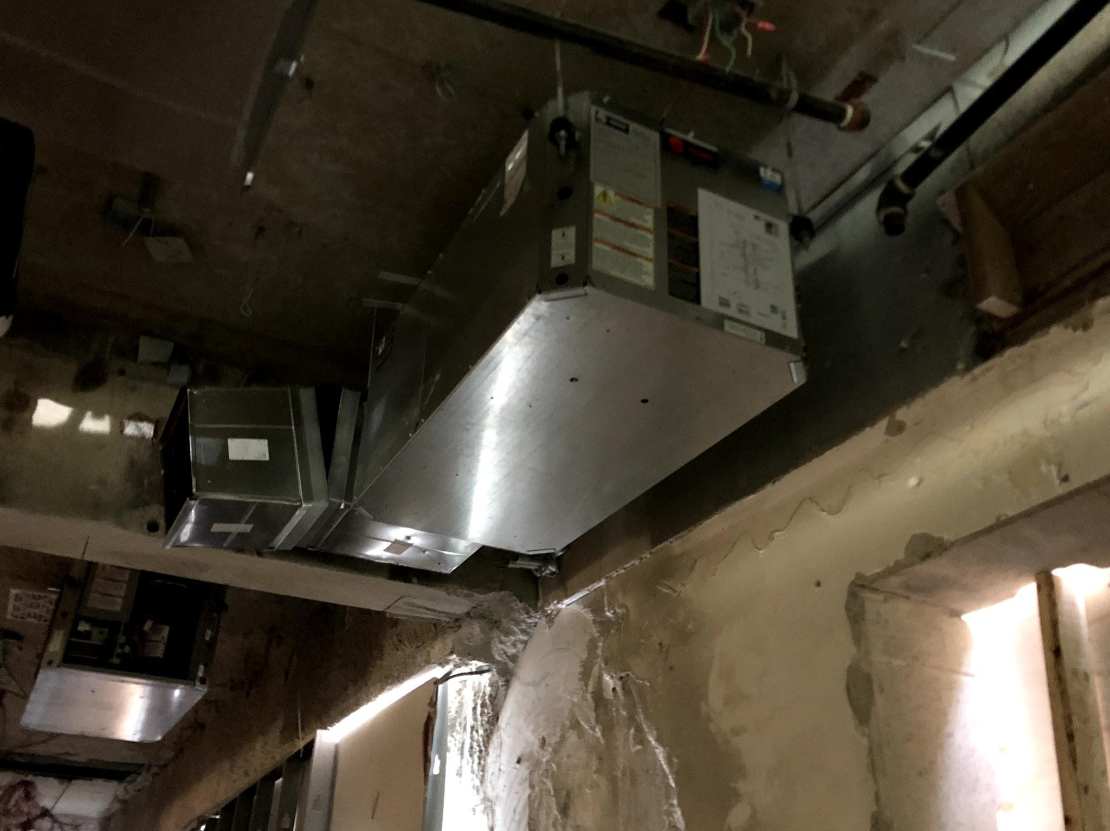
HVAC work has continued inside the renovation. Ventilation ducts have been relocated. Return ducts added and new HP units installed.

Slide 3
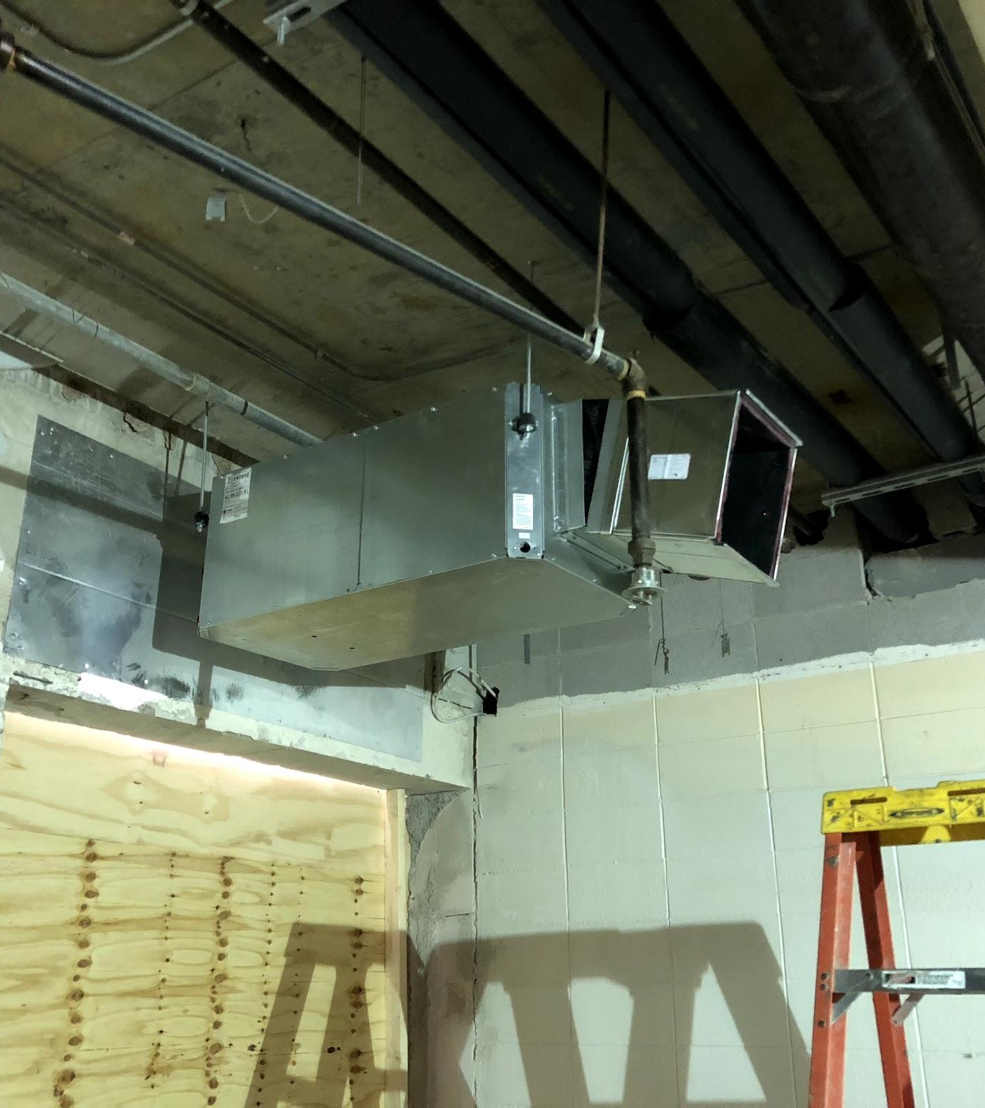
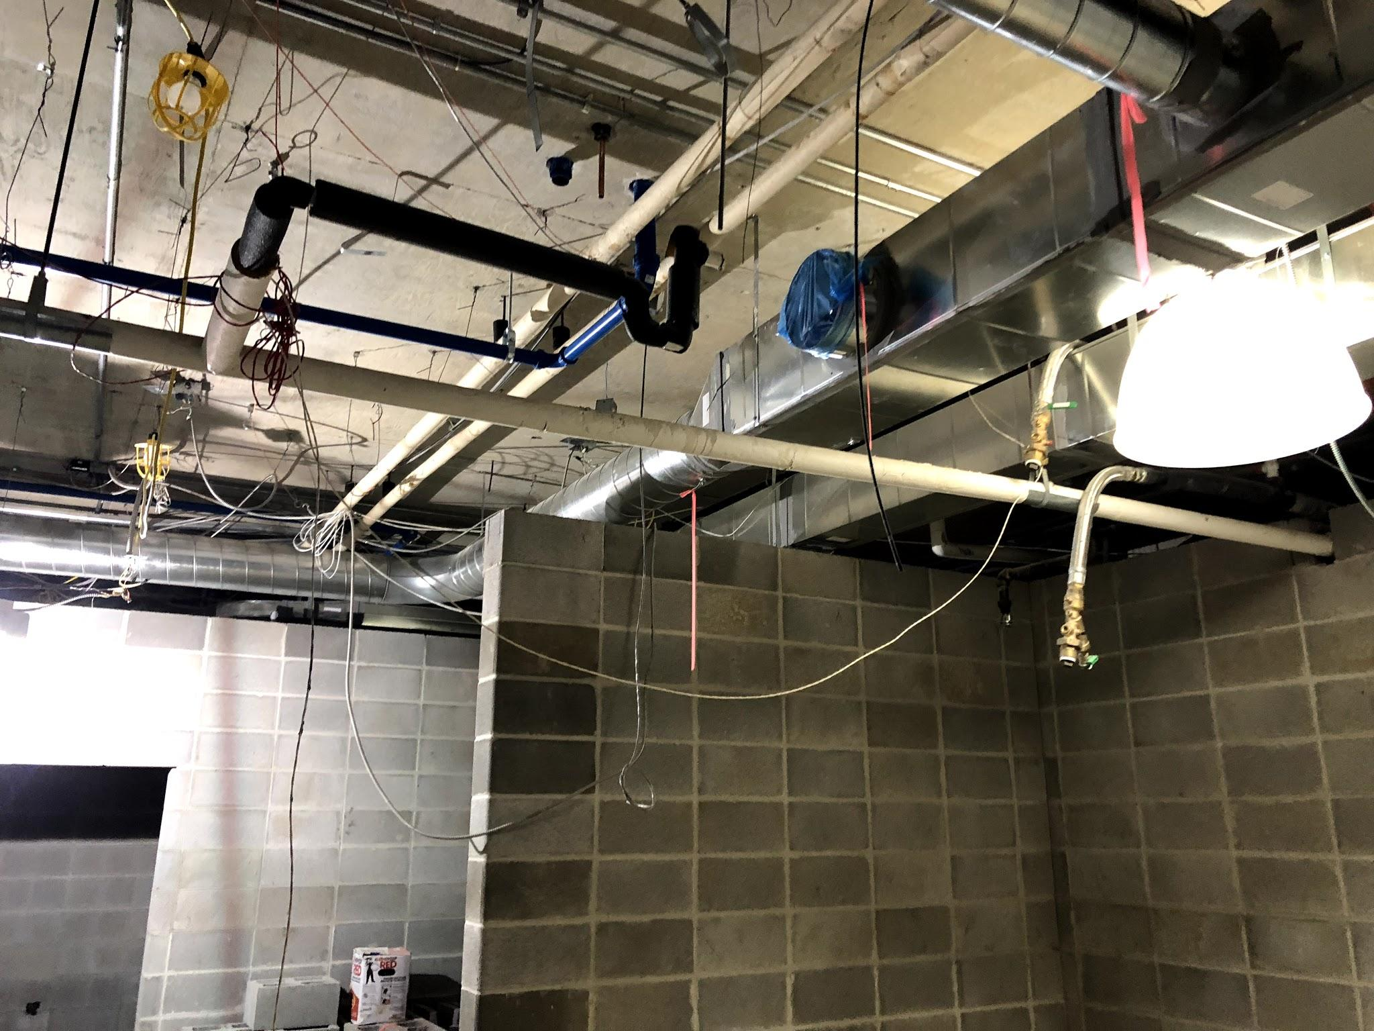
The unseen task of plumbing all of the sinks, restrooms and sprinklers has occurred each evening between the 1st floor ceiling grid and second floor slab.
Lots of work that is needed but never seen.

Slide 4
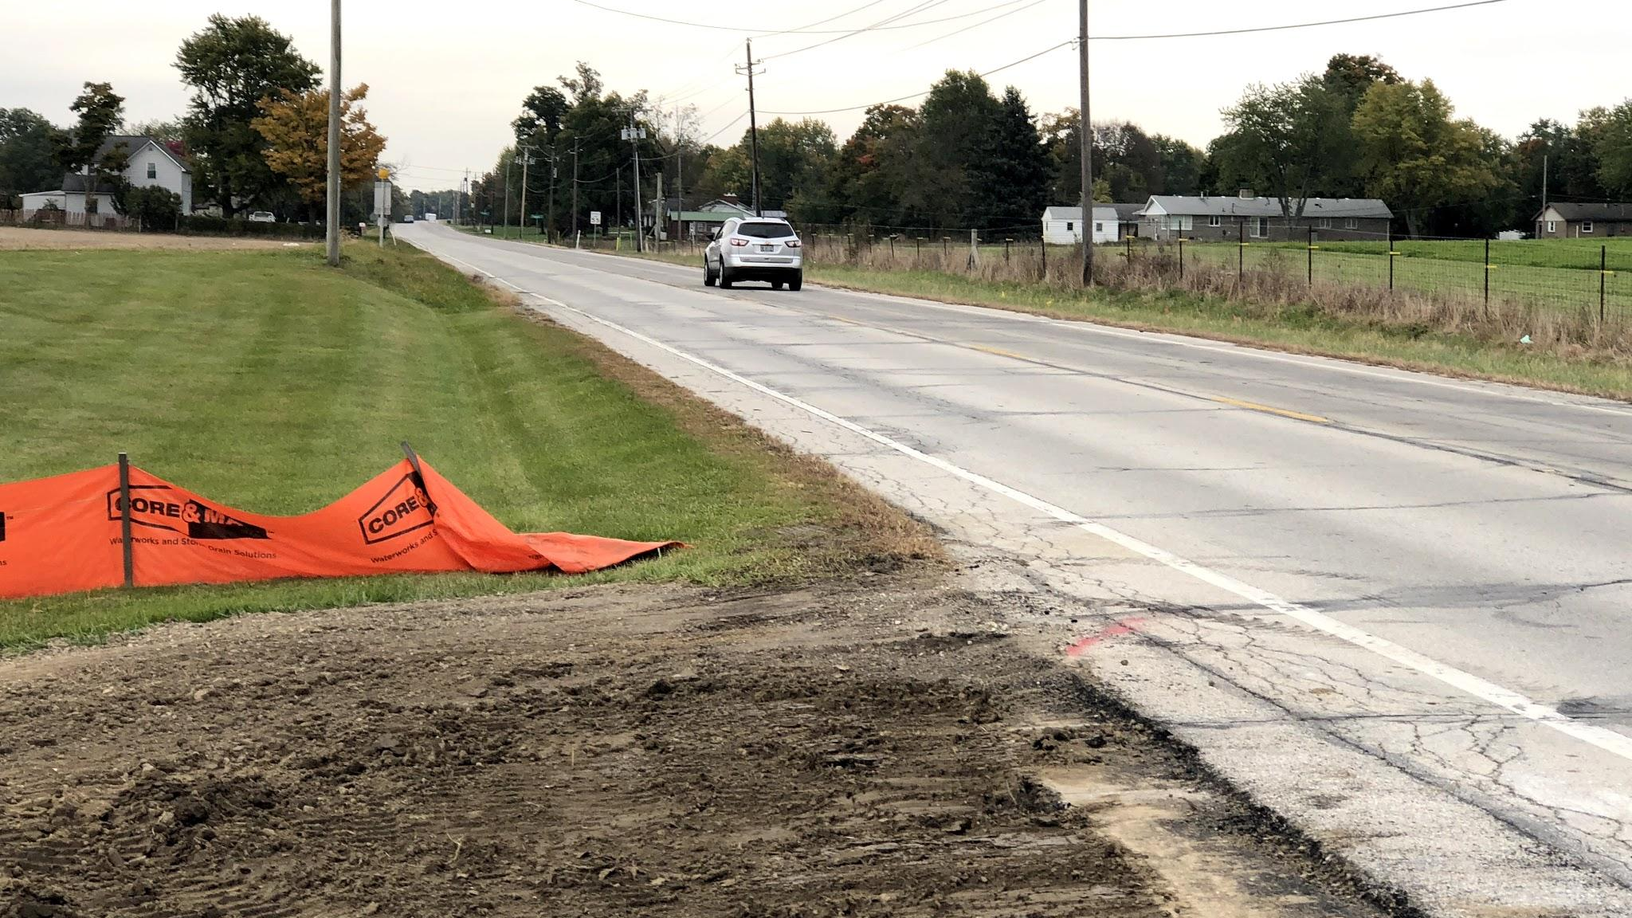
Picture taken at 16’ feet off of Westbound outside stripe. At the elevation of 5’.

Slide 5
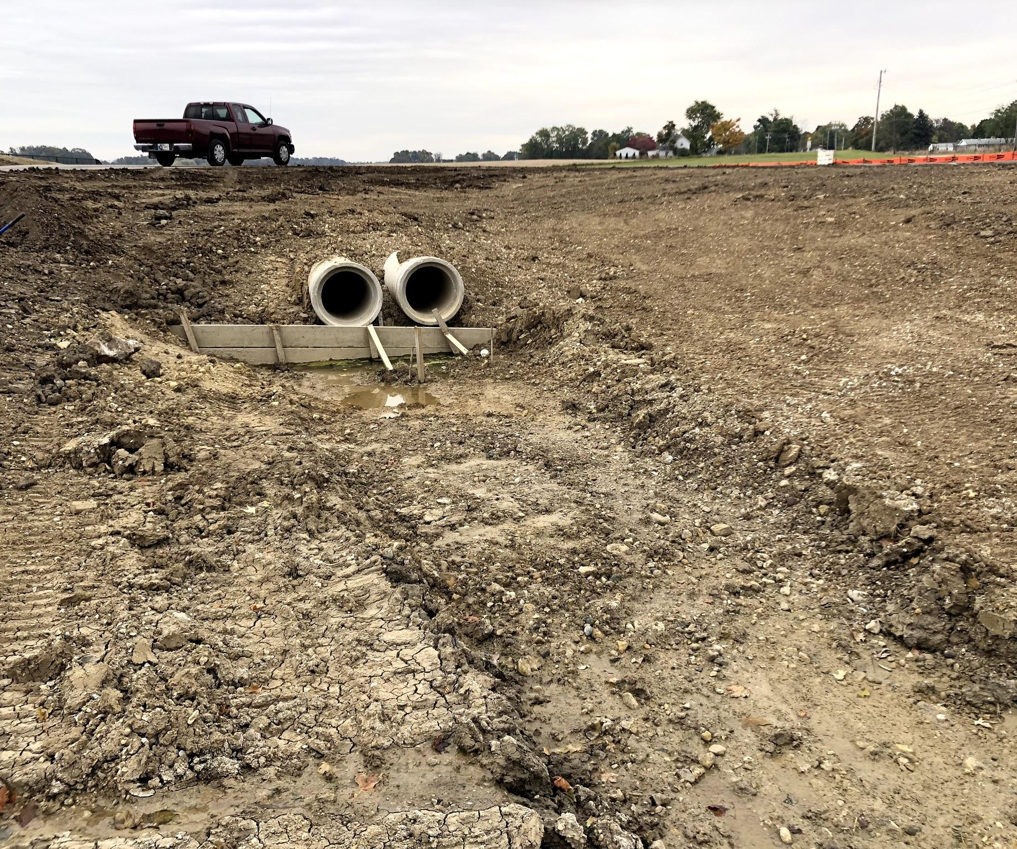
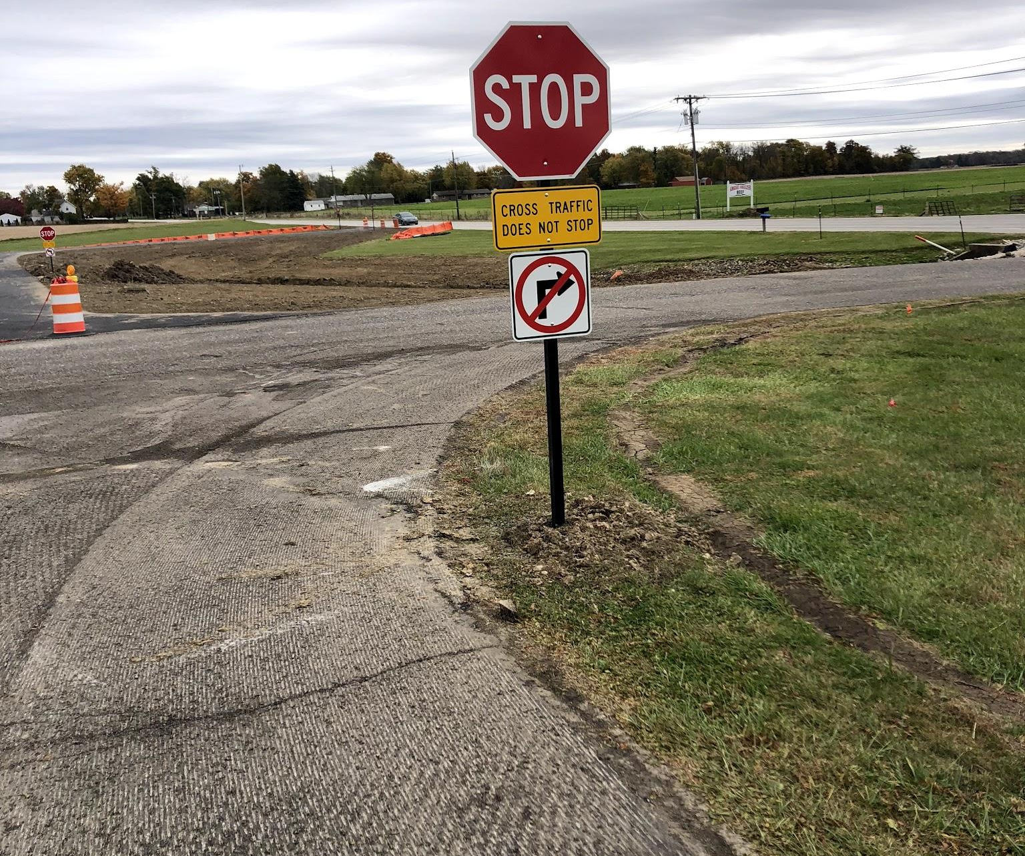
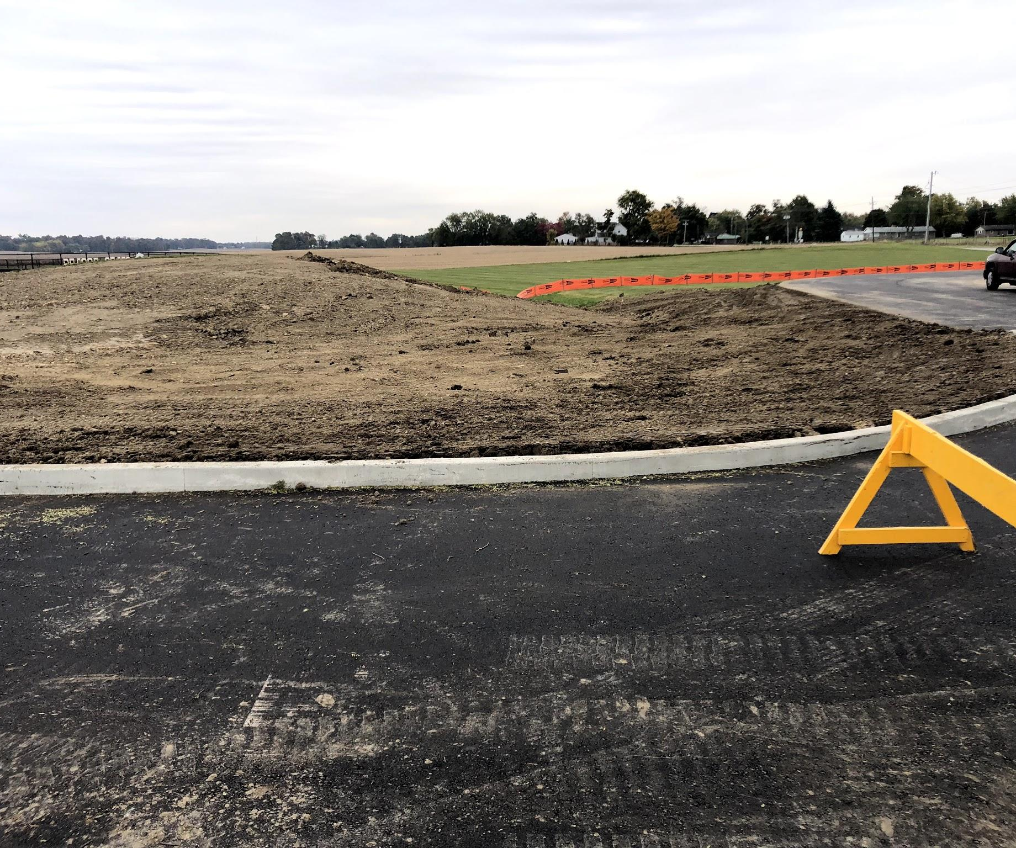
Sitework and signage is ongoing and should finish up in the coming week or two. Striping, directionals, stop bars, signs and lot marking completion really add to the increased safety and functionality we will have in the new lot.

Slide 6
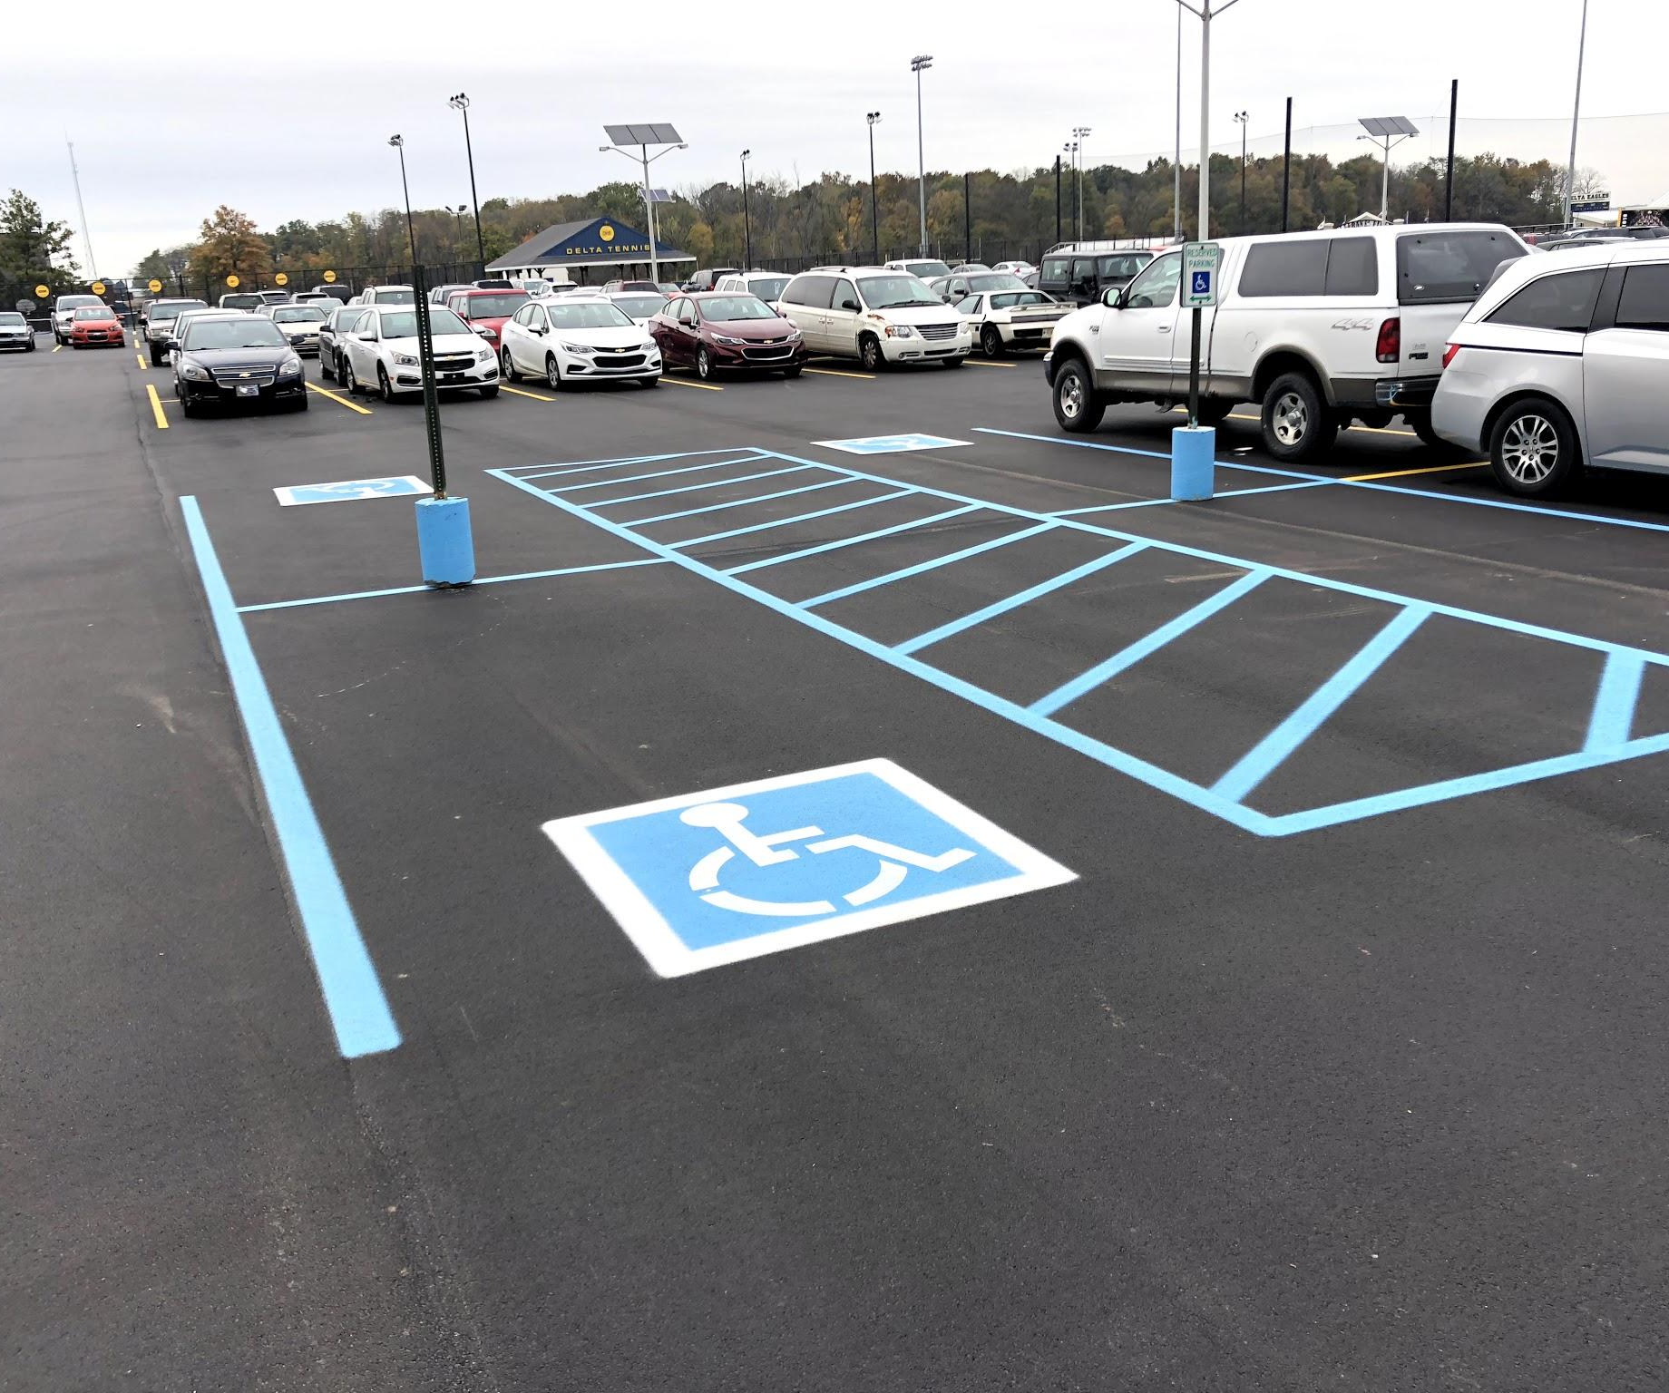
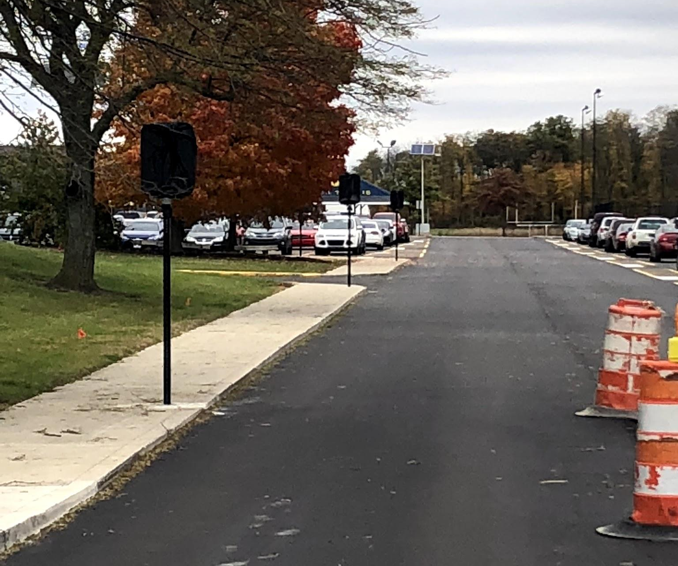
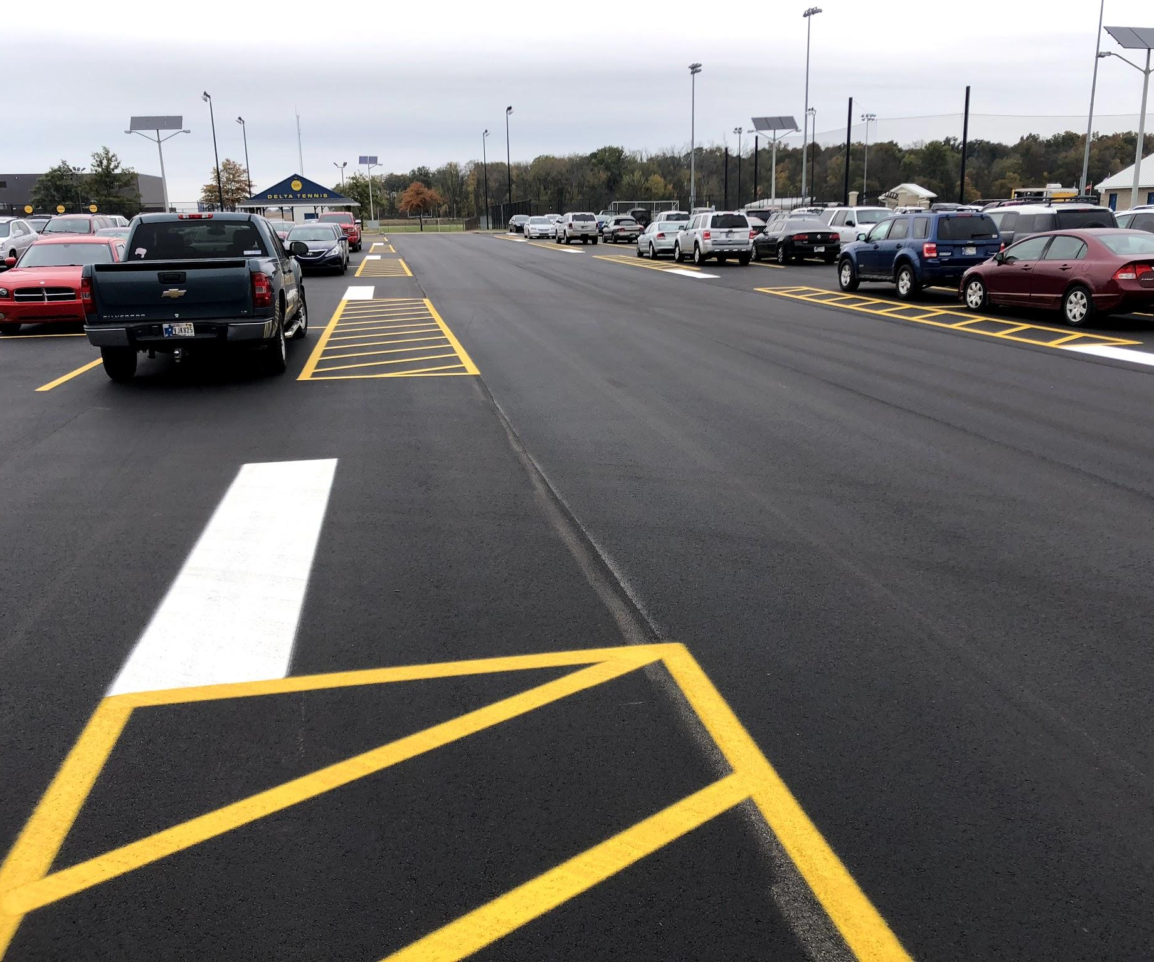

Slide 7
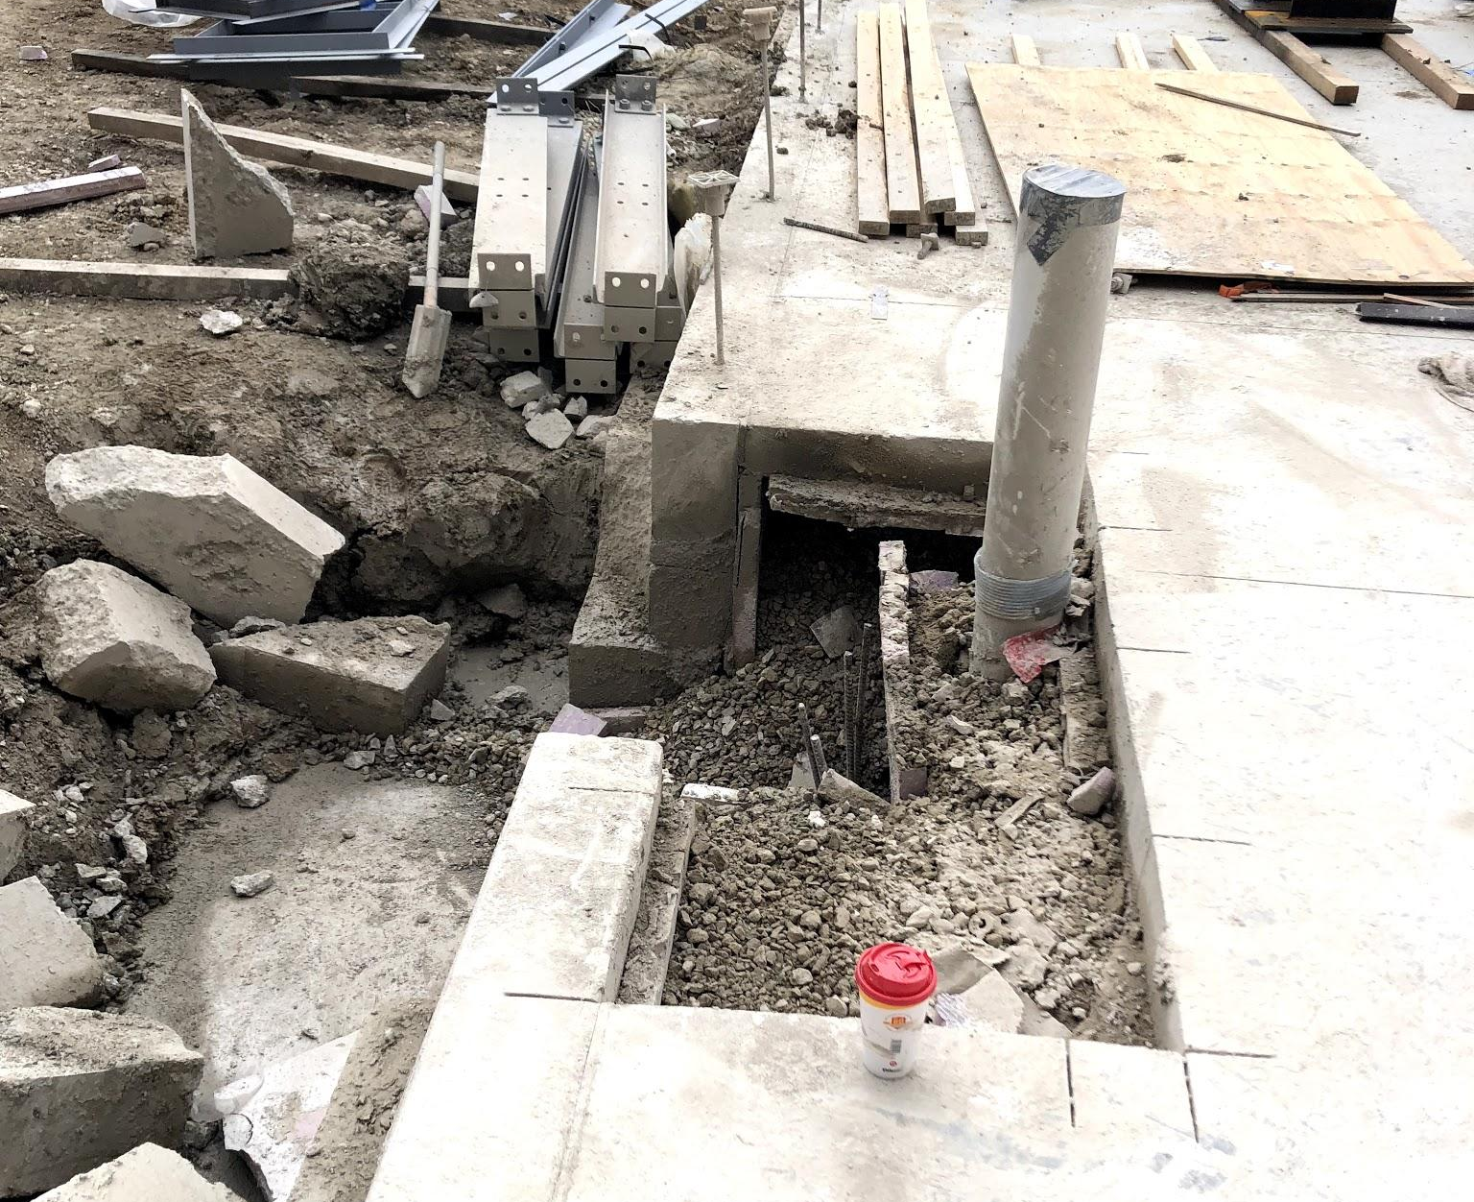
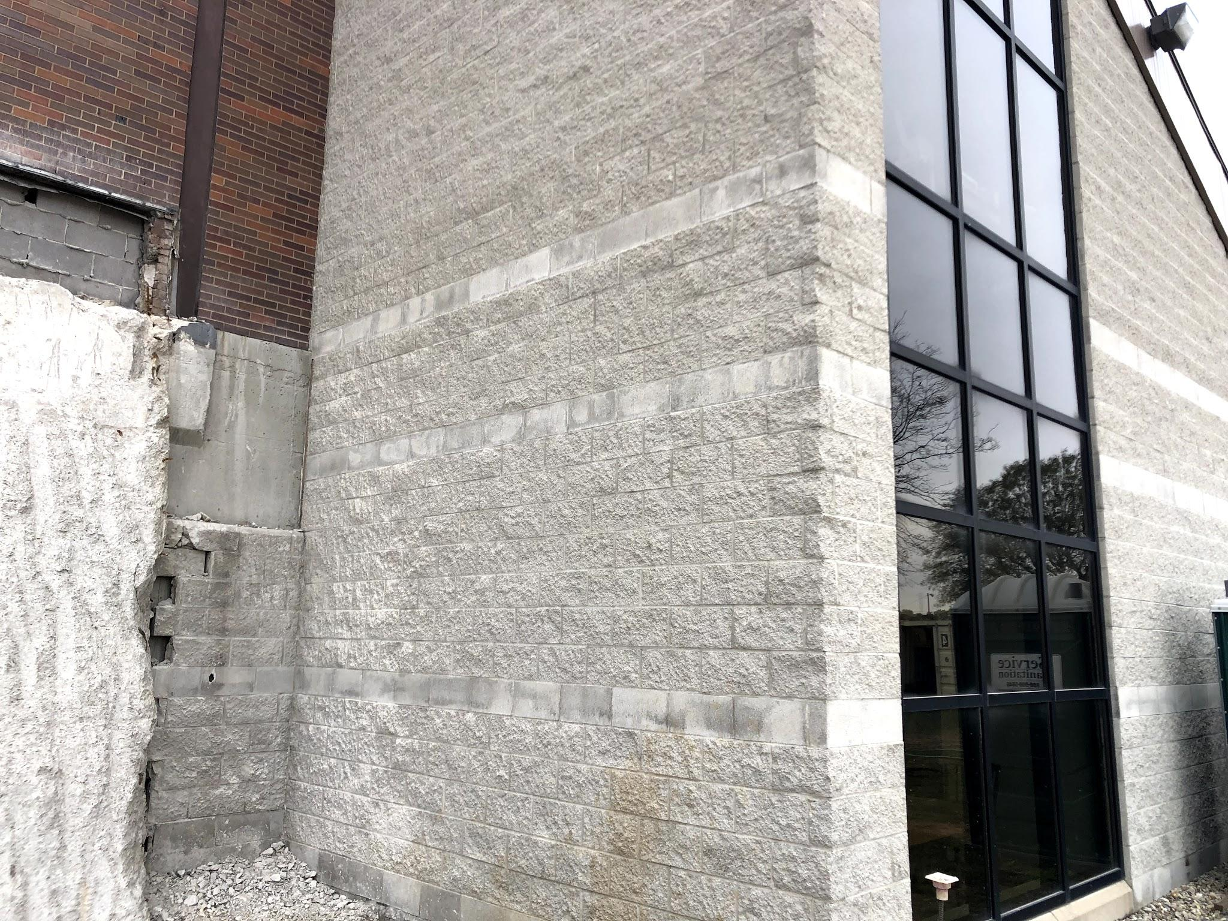
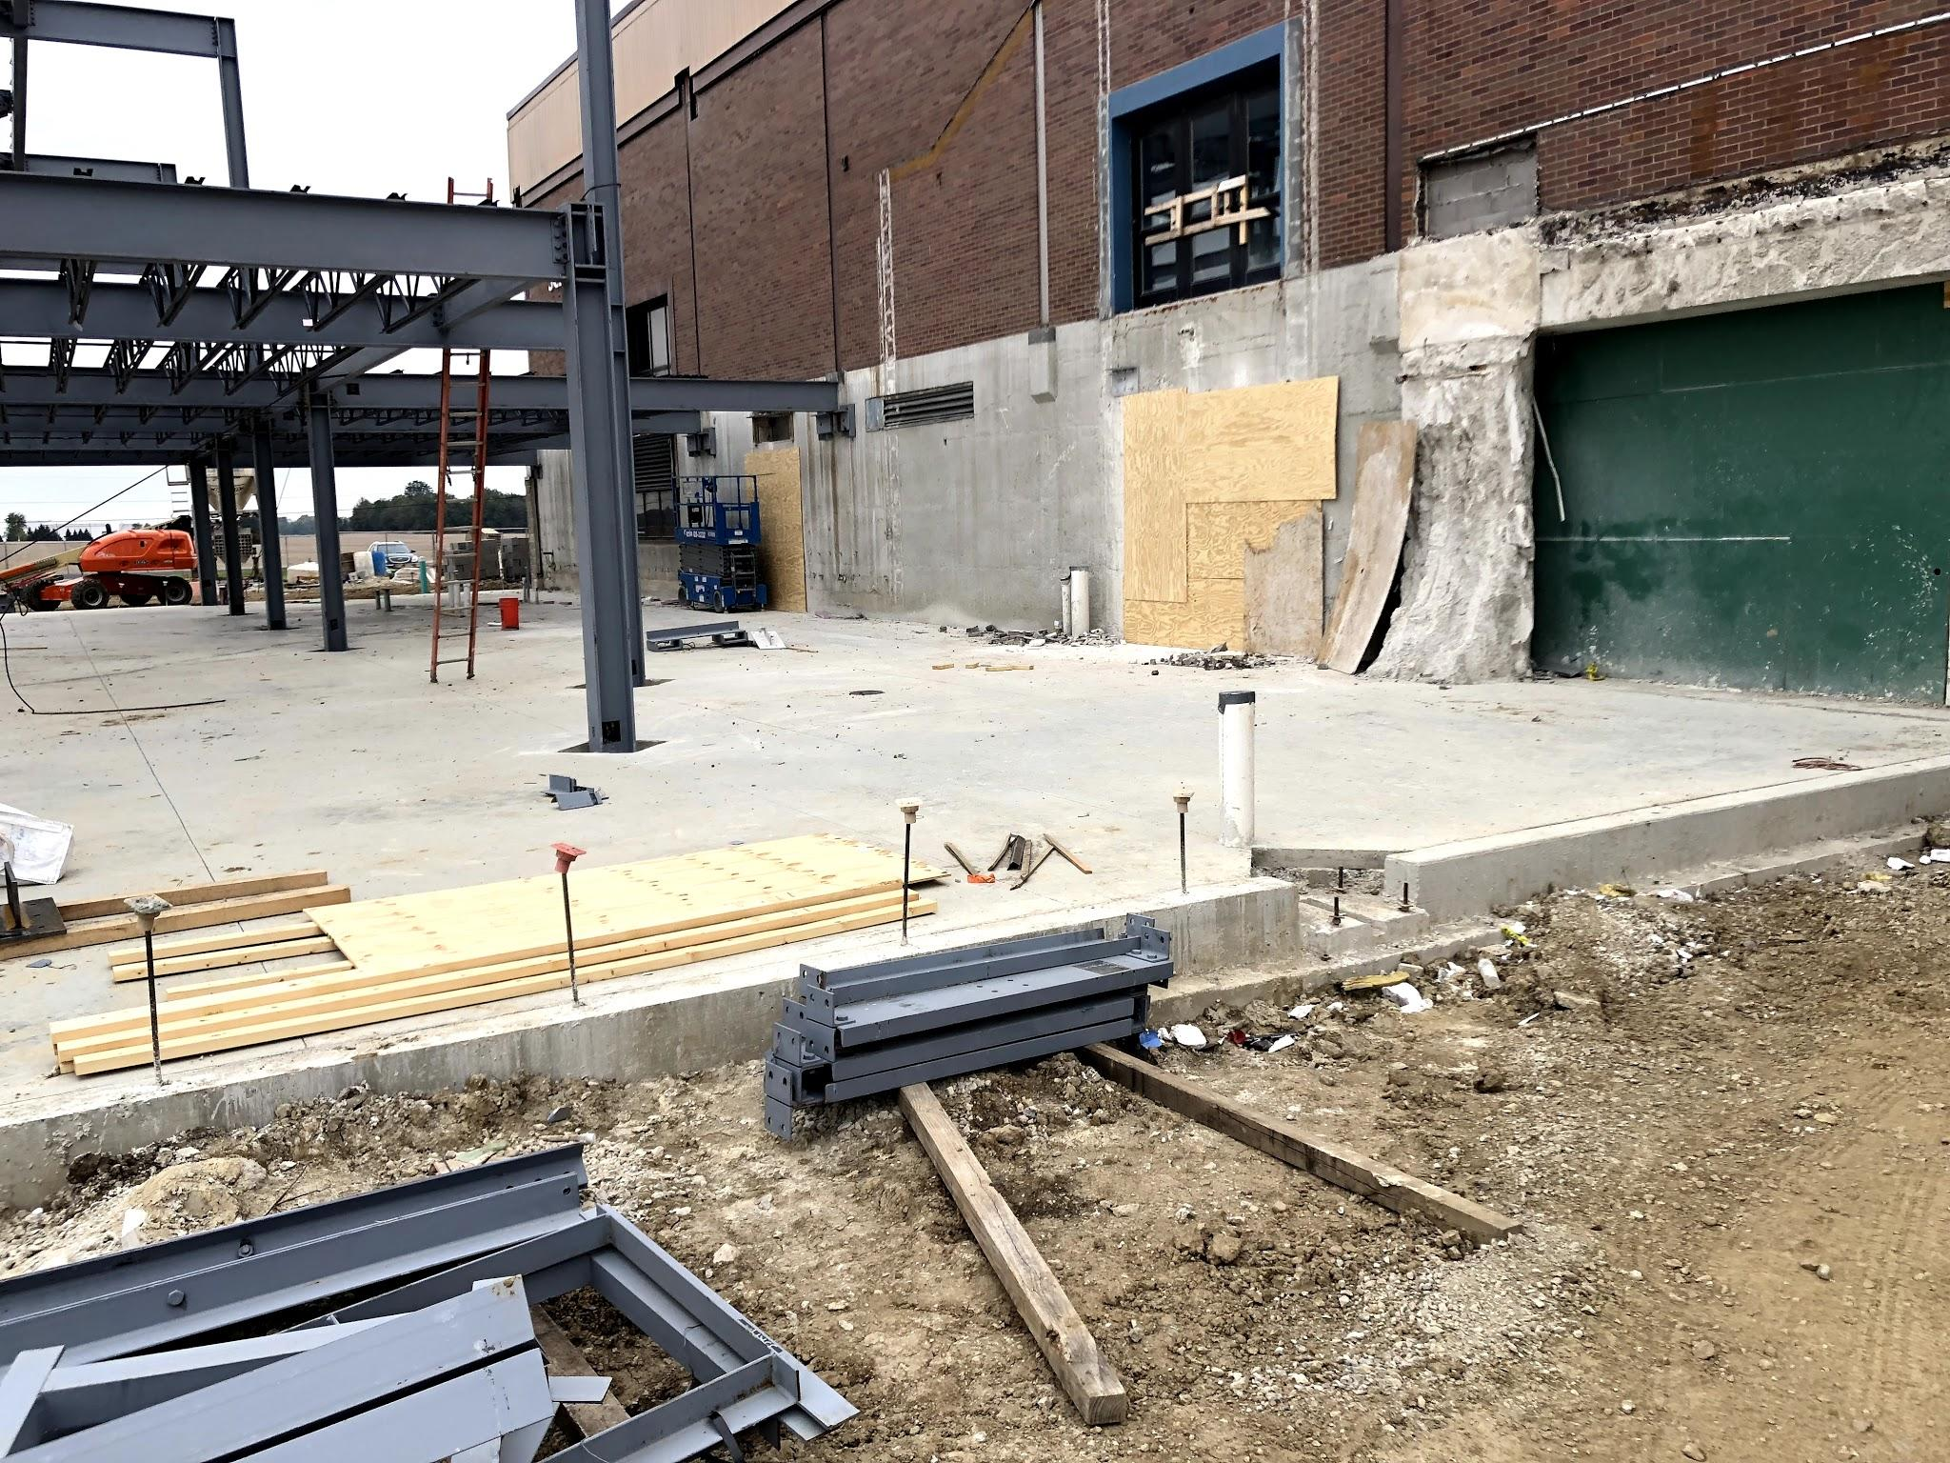
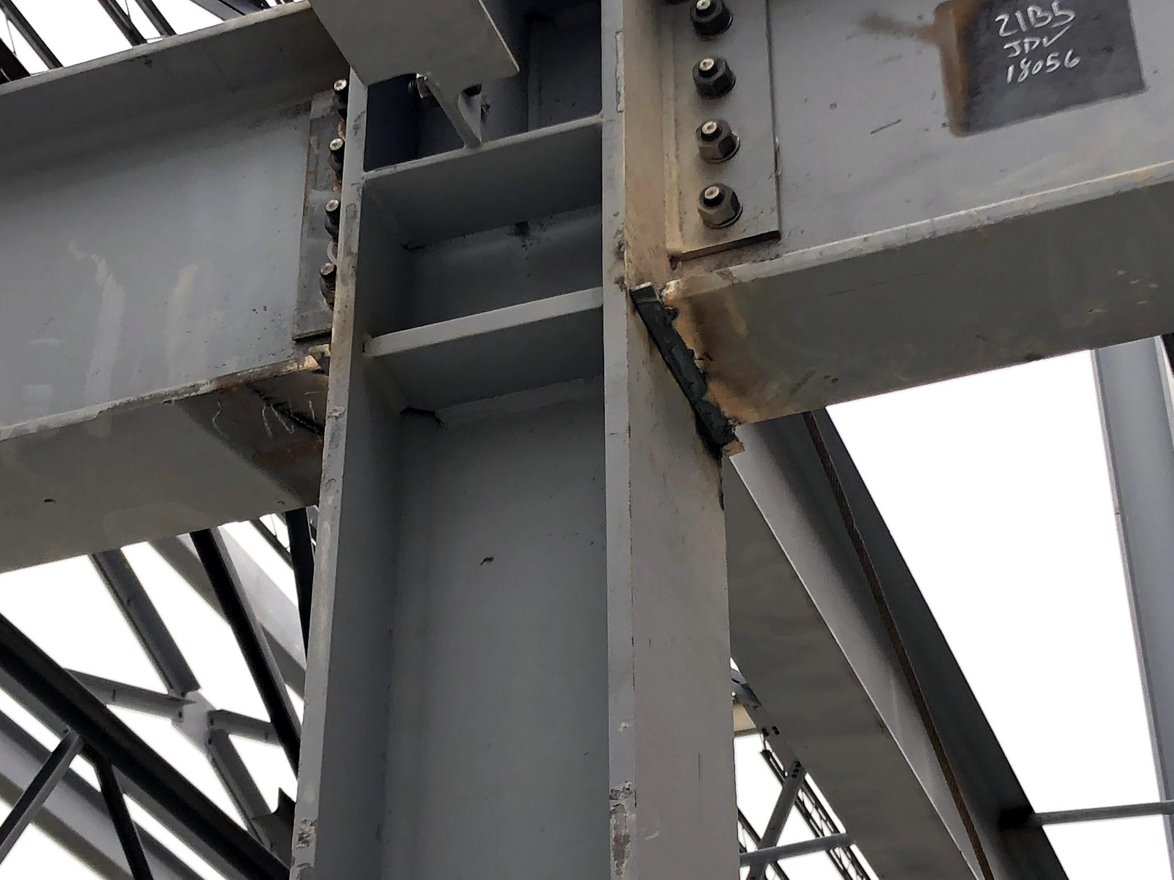
Some challenges have arisen on steel placement and existing construction. These items have been corrected and answered. Work will resume as items in question are delivered. For the time being, ... moment connections have been made.

Slide 8
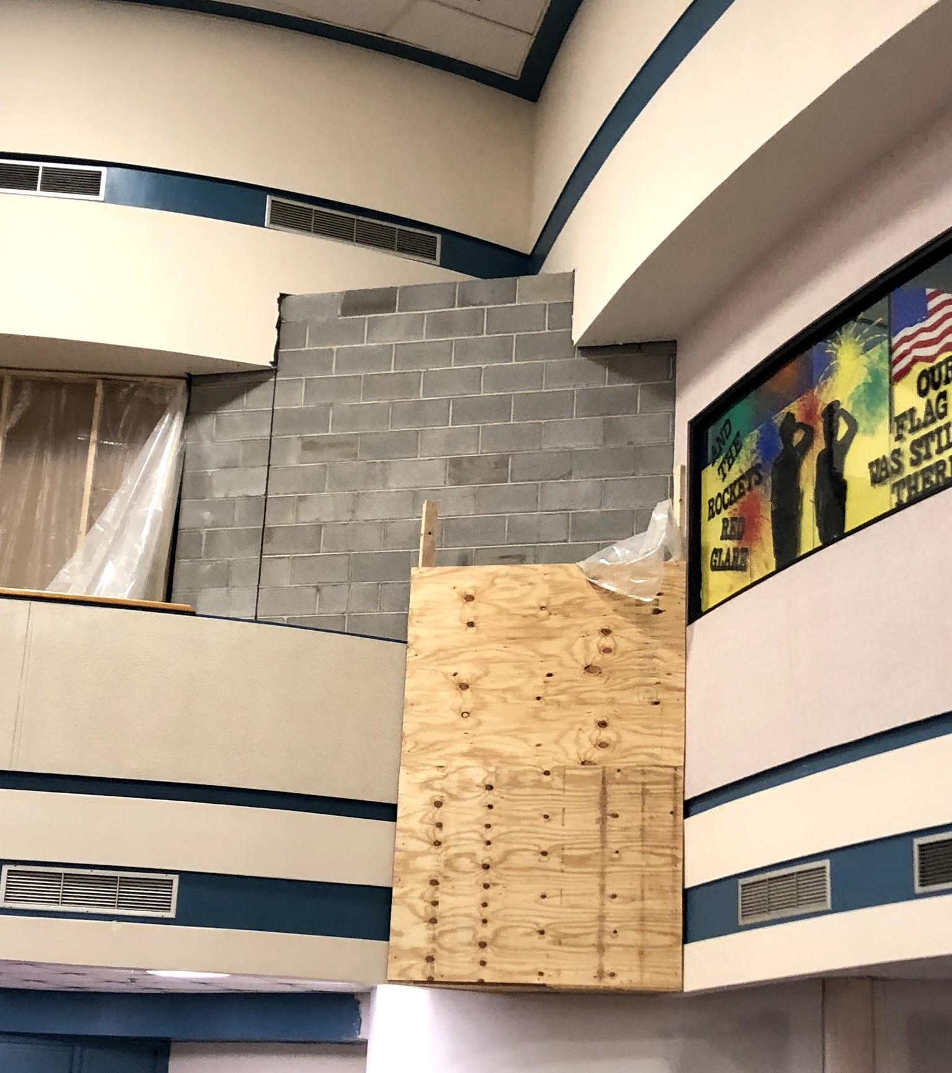
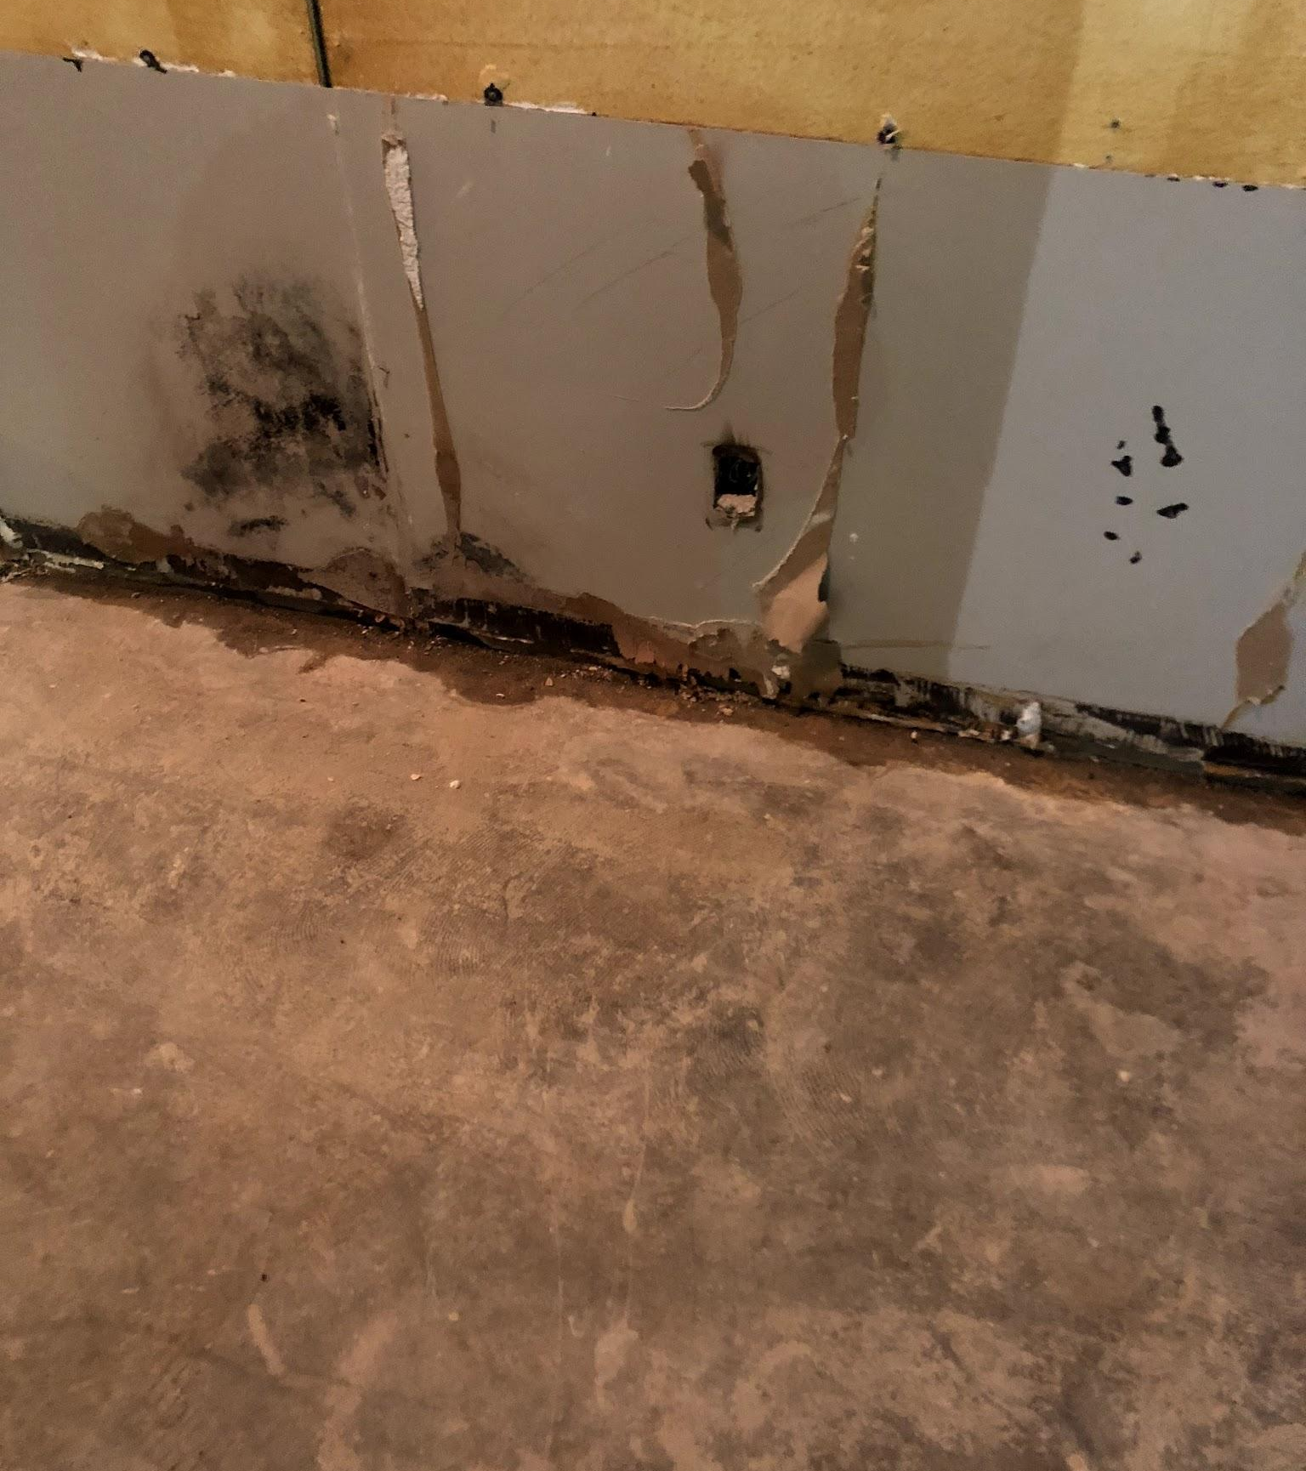
Positive directions have recently been made as well on some of the conditions internally that required extra attention. It is an absolute must to be patient and get things correct during this phase. As an example: The old junction box pictured, appears to have arced as wall coverings were added in the 90’s, before corrective action was taken to remove the power supply.

